Slide 1
Point to Site VPN with Microsoft Azure
Hardik Mistry
Skype: mistryhardik05

Slide 2
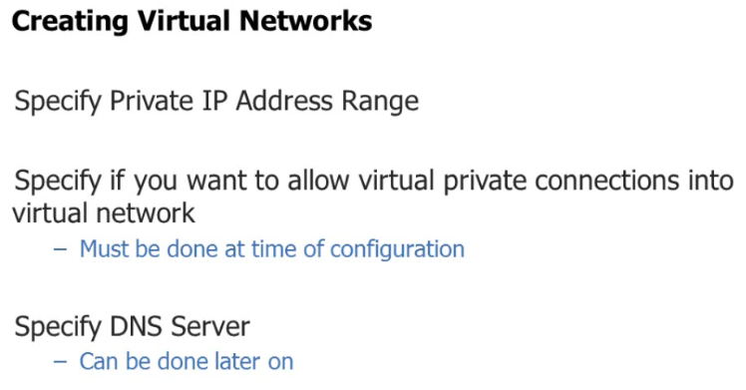

Slide 3
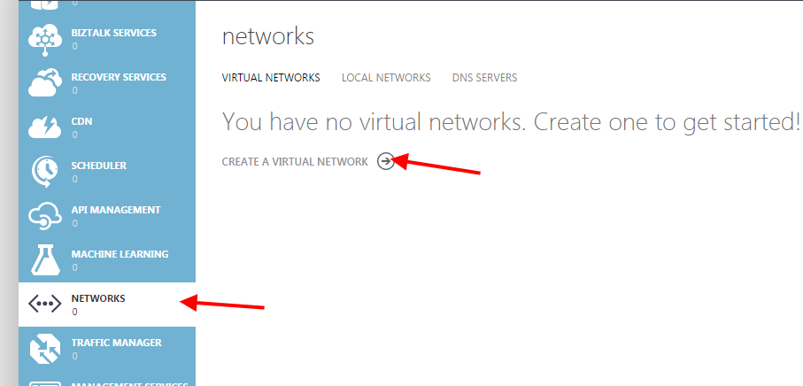

Slide 4
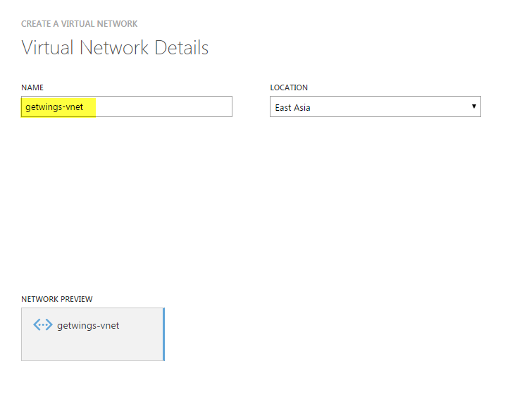

Slide 5
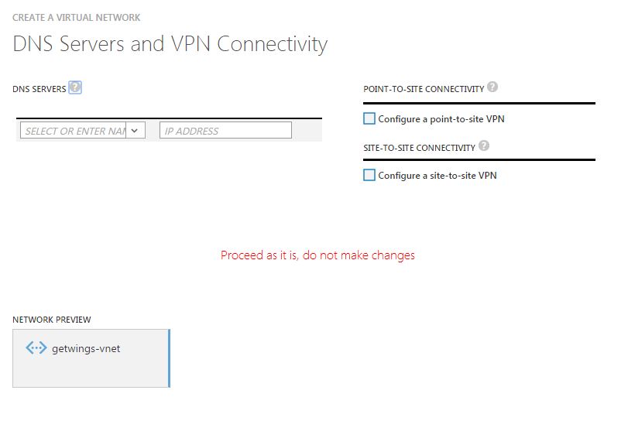

Slide 6
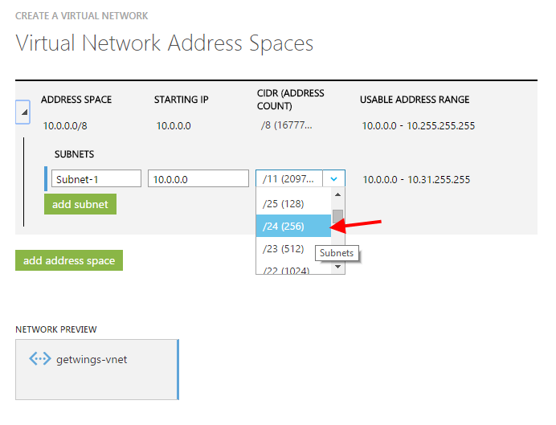

Slide 7
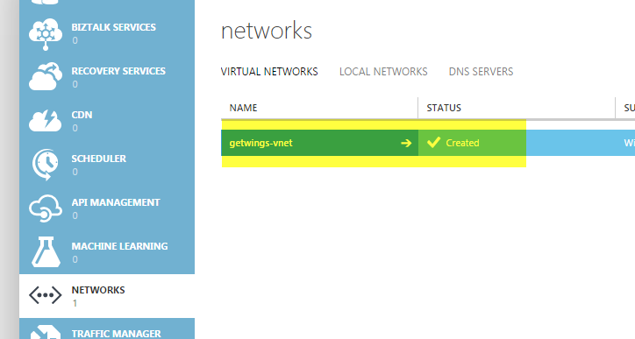

Slide 8
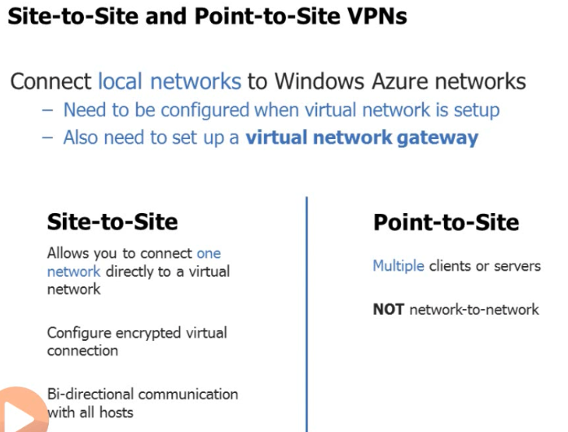

Slide 9
http://mythoughtsonit.com/2013/05/azure-new-point-to-site-vpn/
http://azure.microsoft.com/blog/2014/06/10/expressroute-or-virtual-network-vpn-whats-right-for-me/
http://weblogs.asp.net/scottgu/windows-azure-improvements-to-virtual-networks-virtual-machines-cloud-services-and-a-new-ruby-sdk

Slide 10
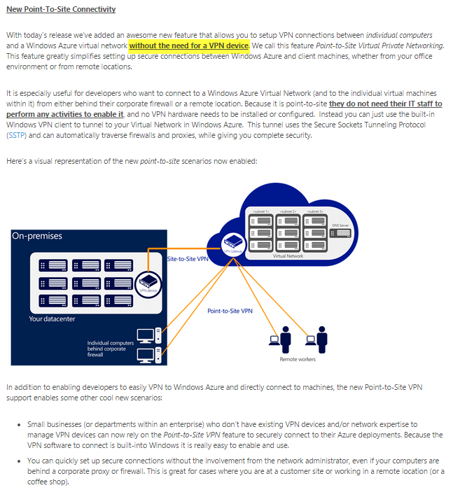

Slide 11
2: Add a DNS server

Slide 12
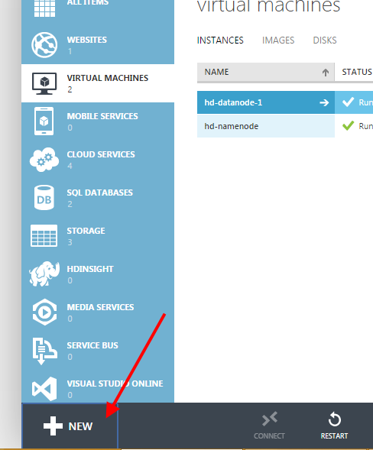

Slide 13
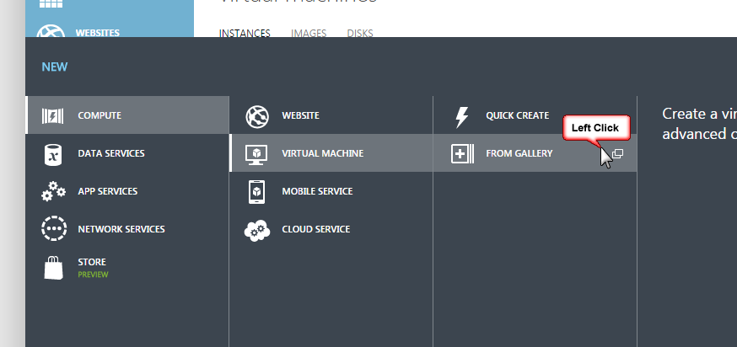

Slide 14
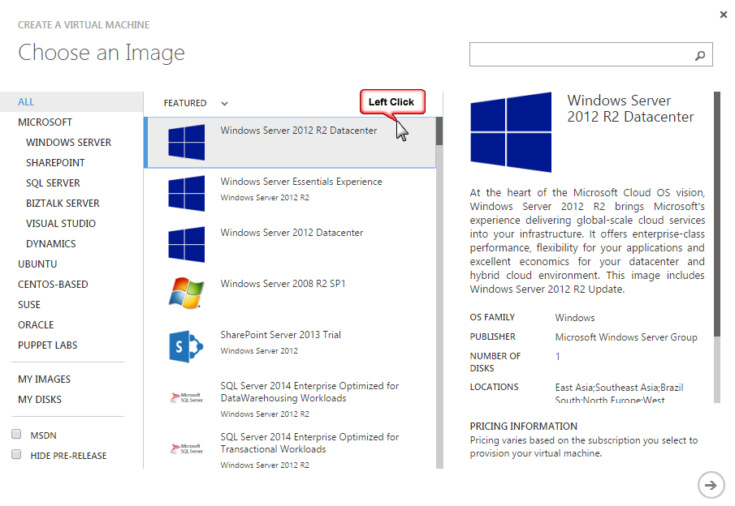

Slide 15
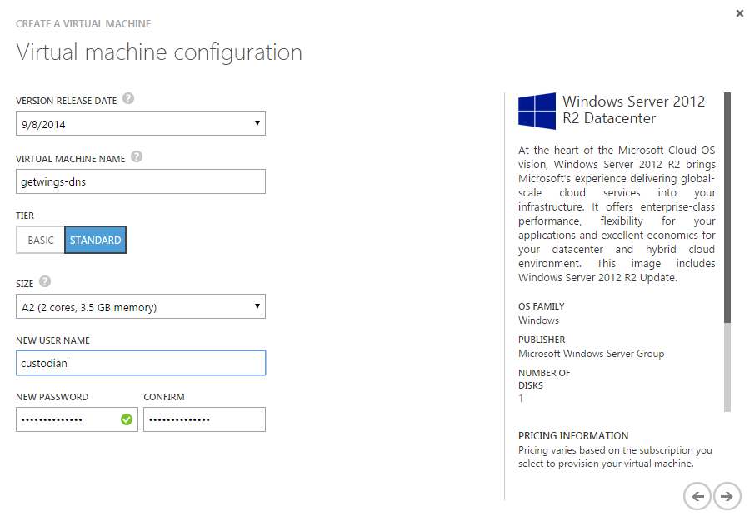

Slide 16
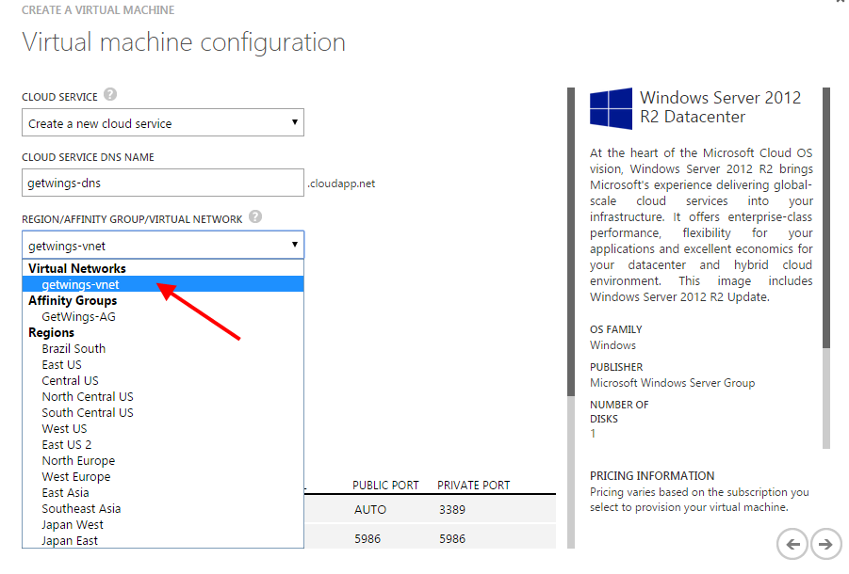

Slide 17
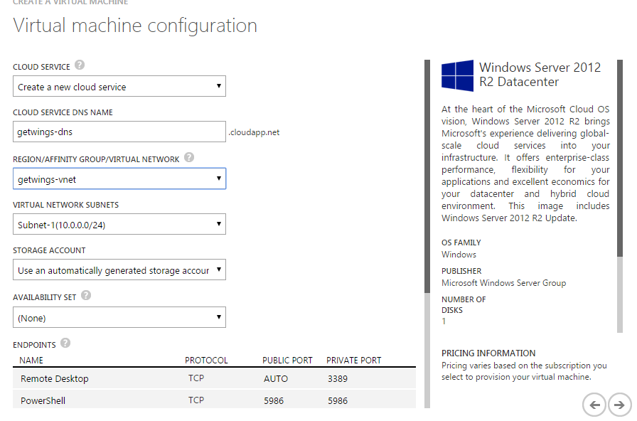

Slide 18
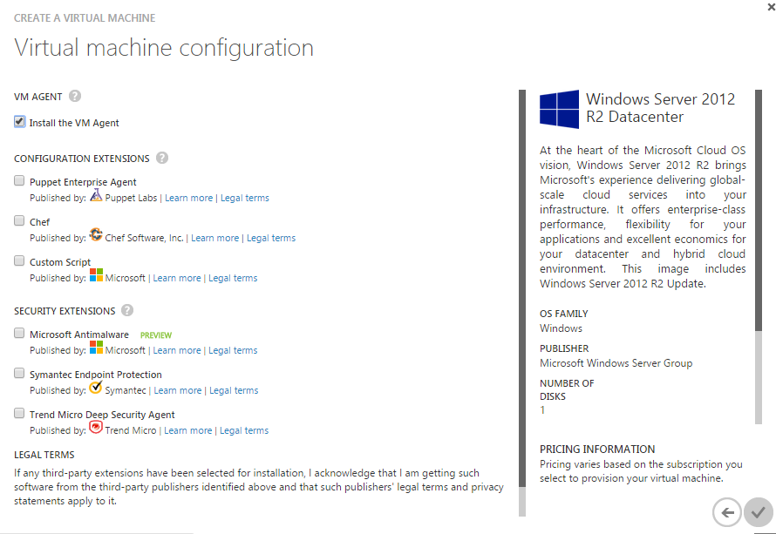

Slide 19
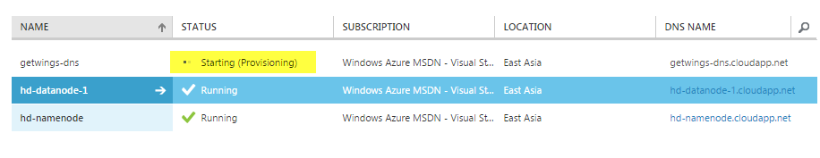

Slide 20
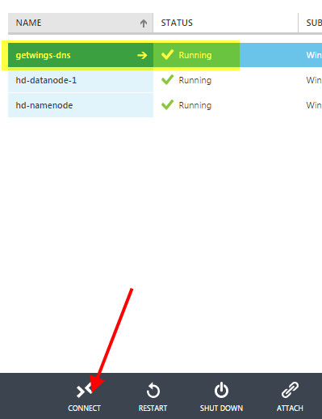

Slide 21
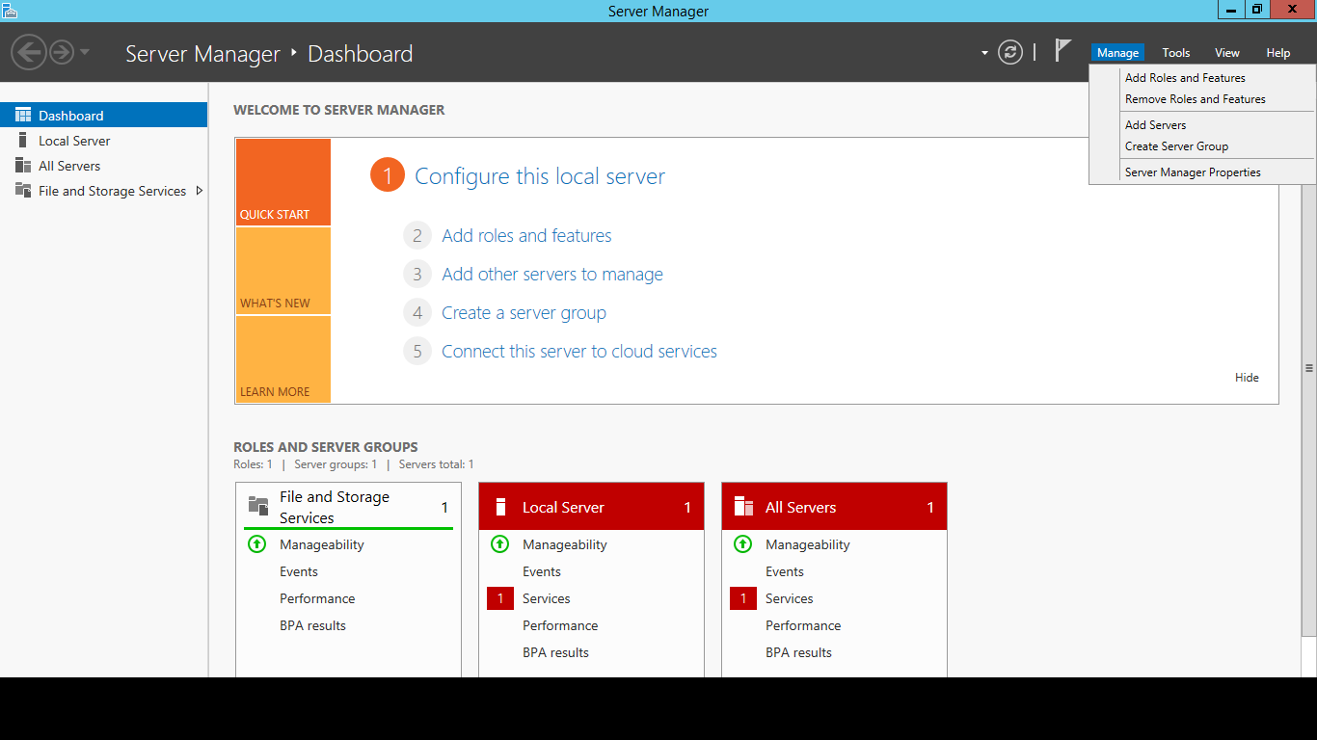

Slide 22
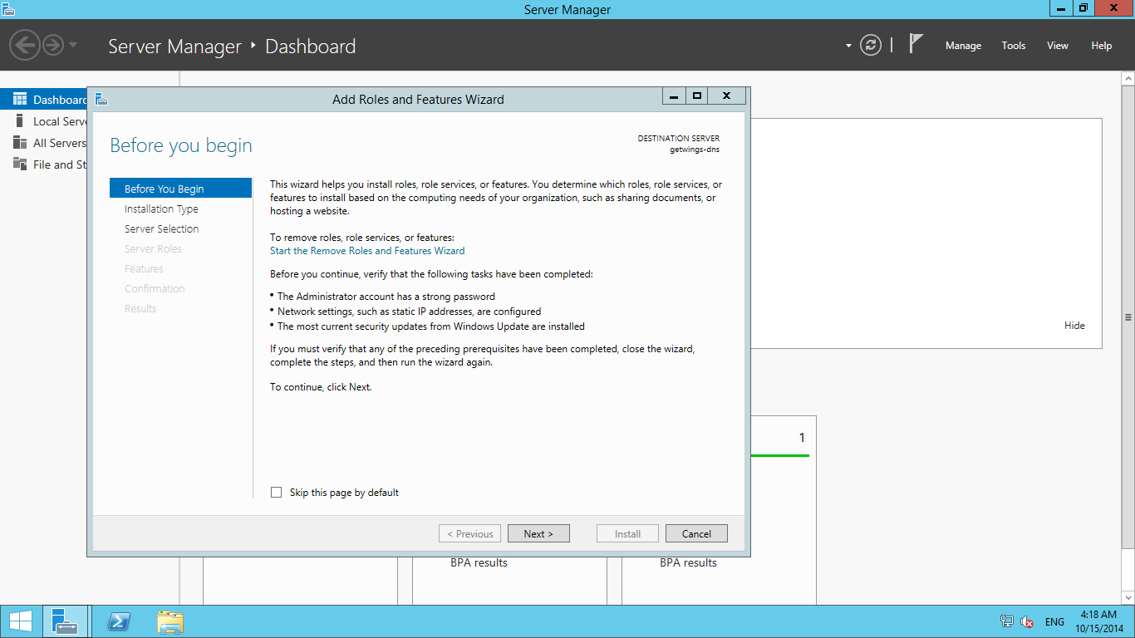

Slide 23
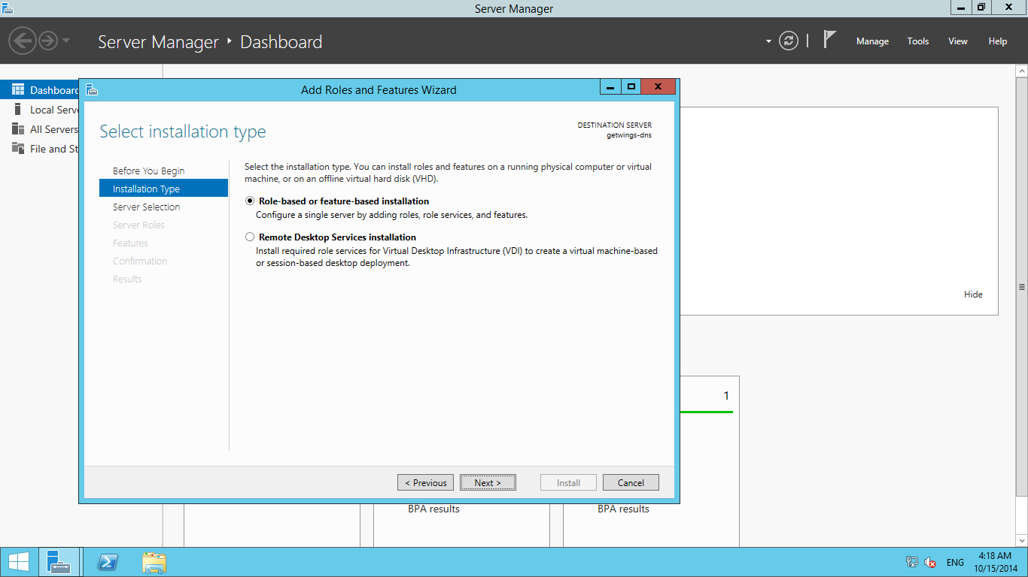

Slide 24
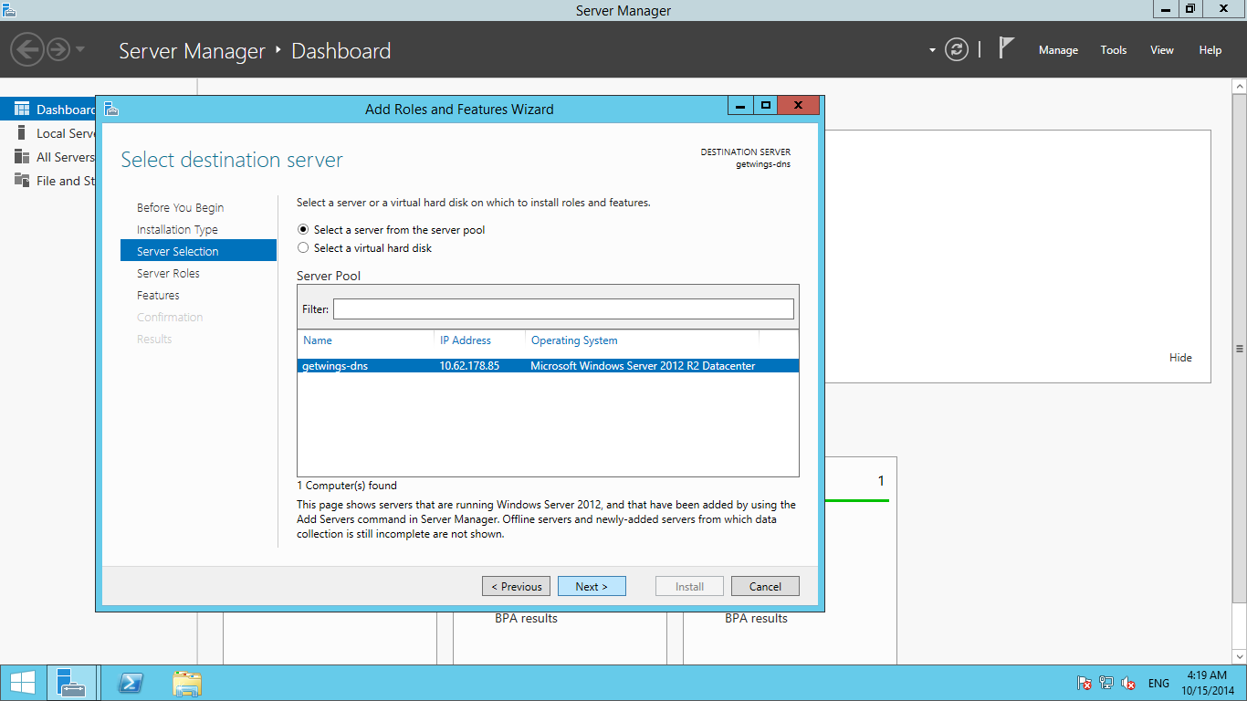

Slide 25
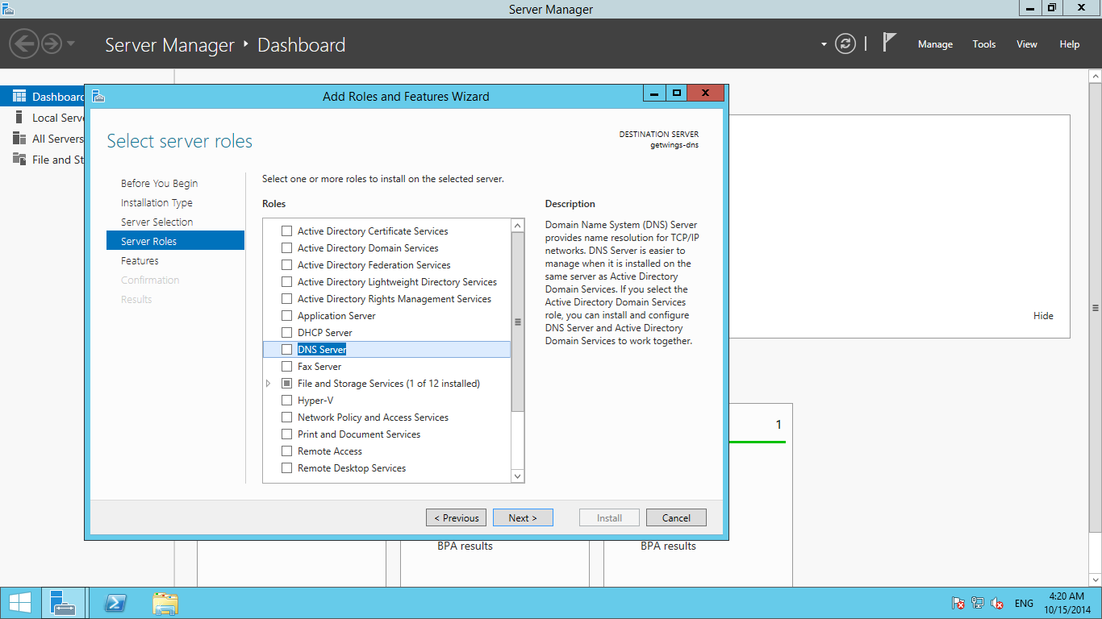

Slide 26
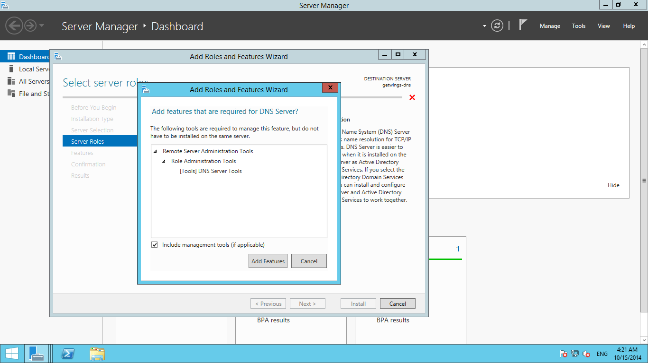

Slide 27
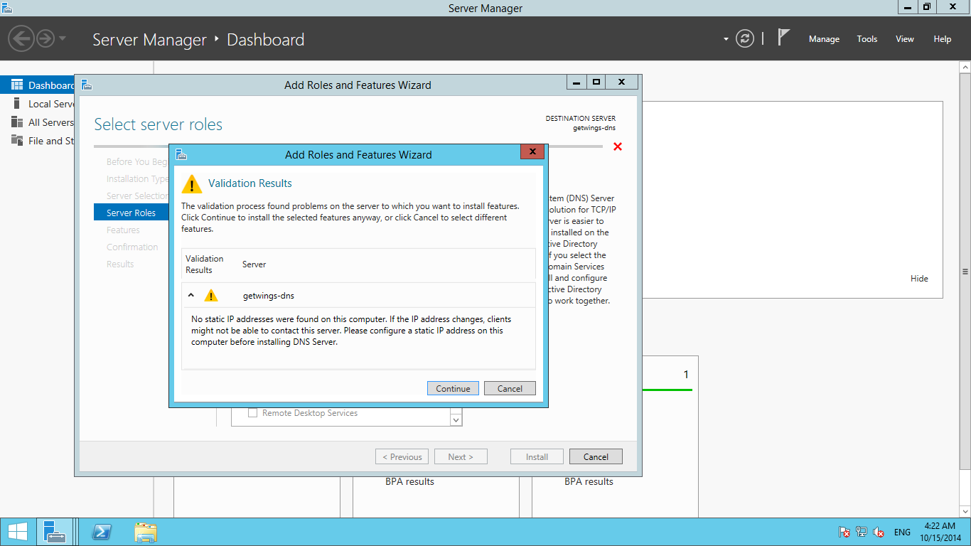

Slide 28


Slide 29
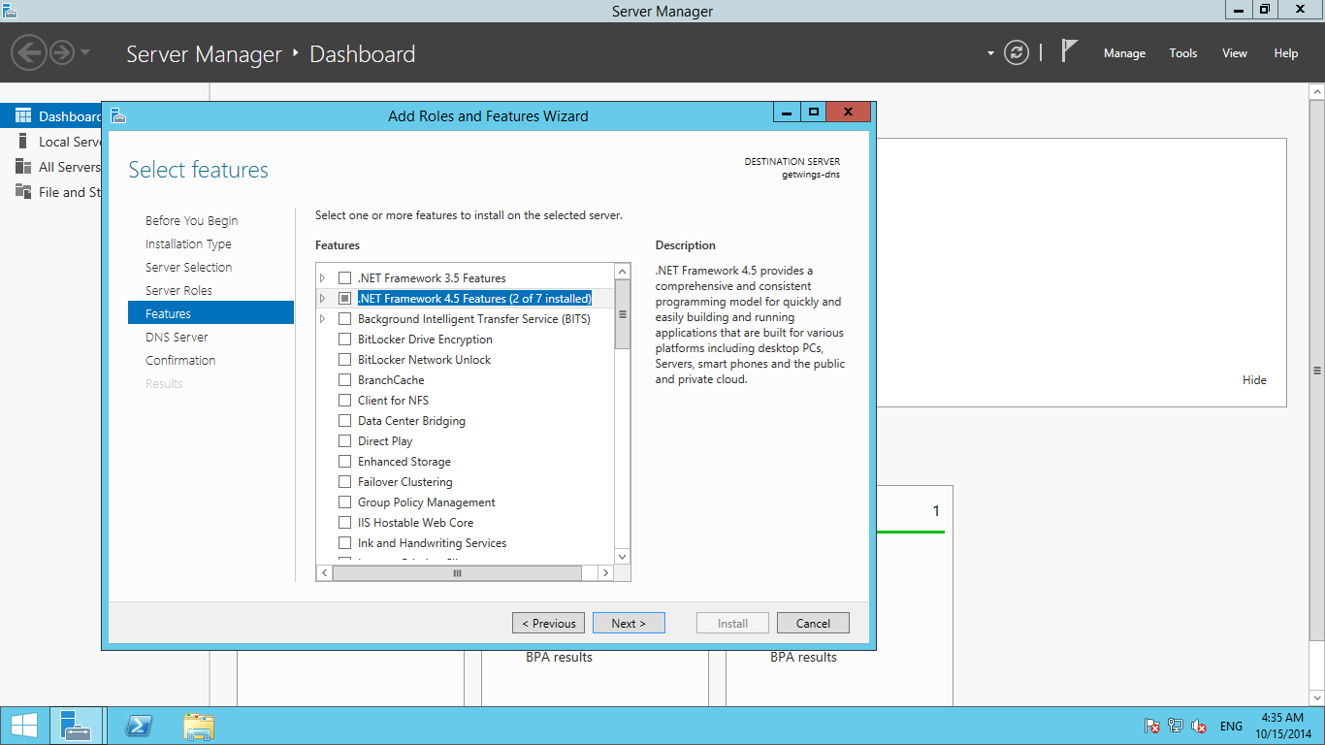

Slide 30
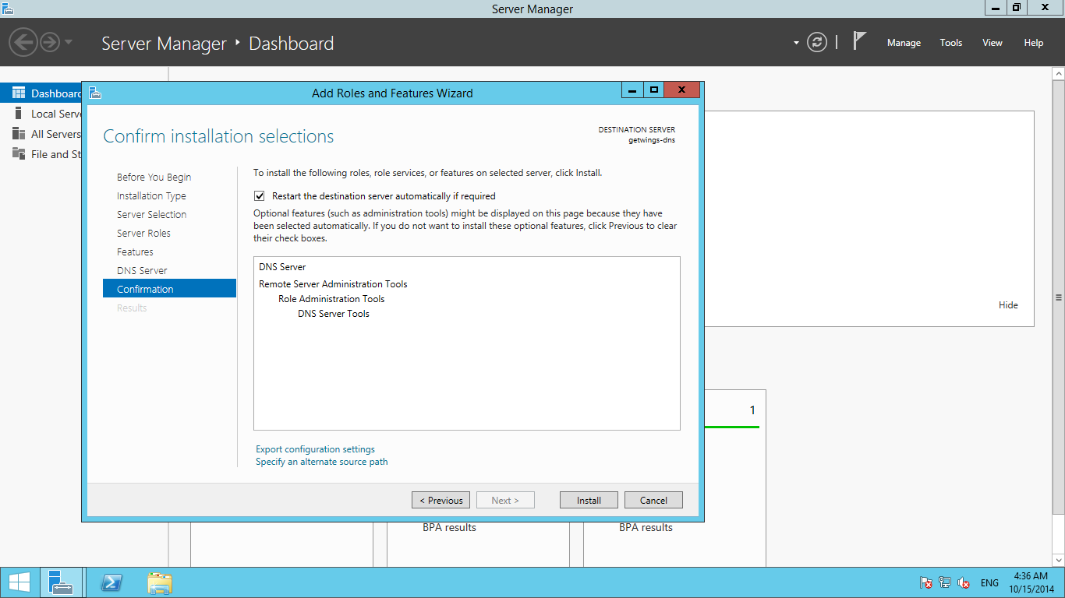

Slide 31
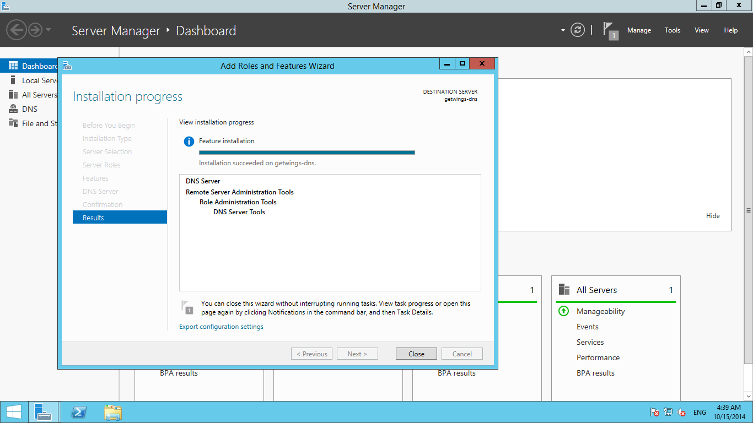

Slide 32
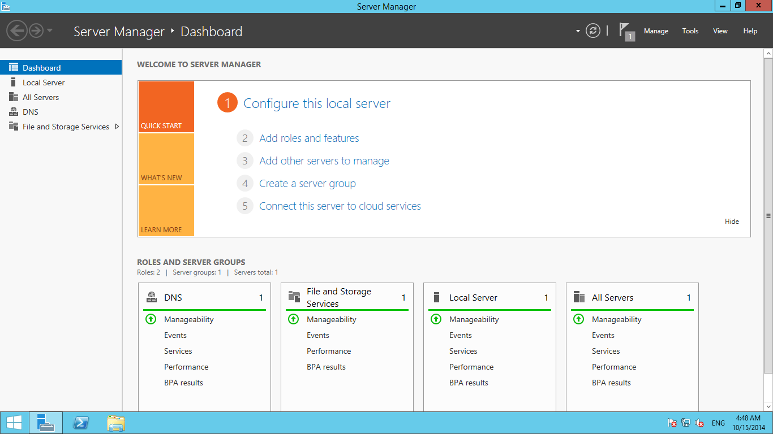

Slide 33
Verify the current DNS server IP assigned to the server
Use powershell
Type ipconfig /all to get list of all network adapters

Slide 34
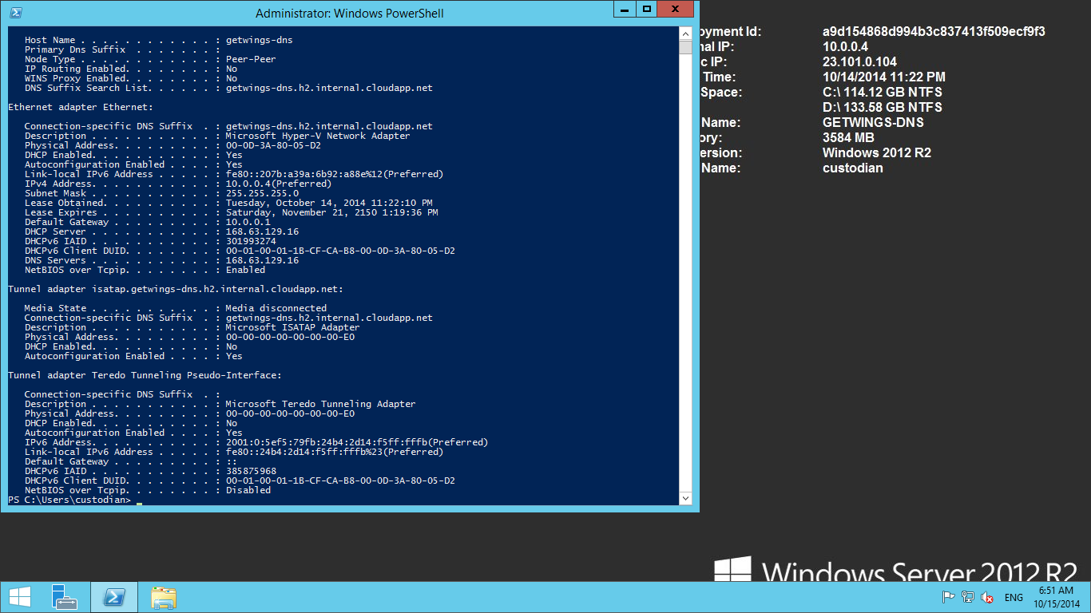

Slide 35
3. Configure the virtual network to use the DNS
server that we created in step 2

Slide 36
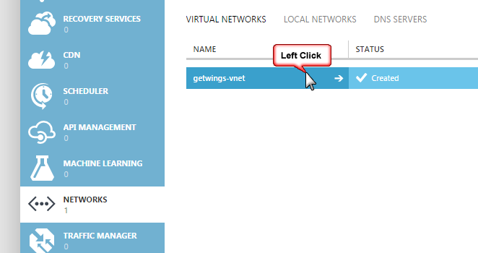

Slide 37
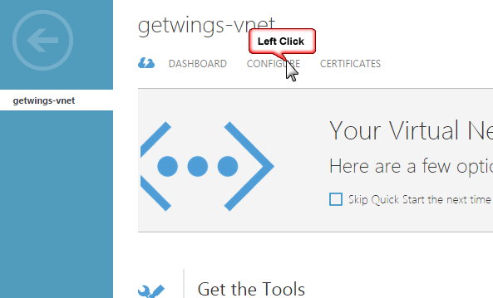

Slide 38
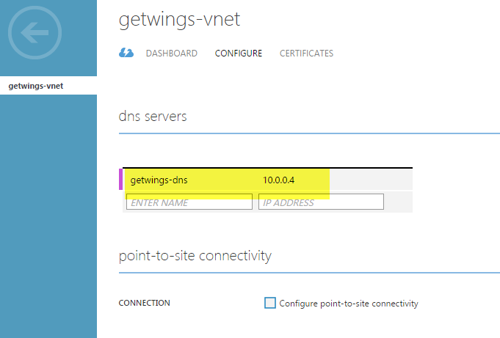

Slide 39
4. Restart the DNS Server

Slide 40
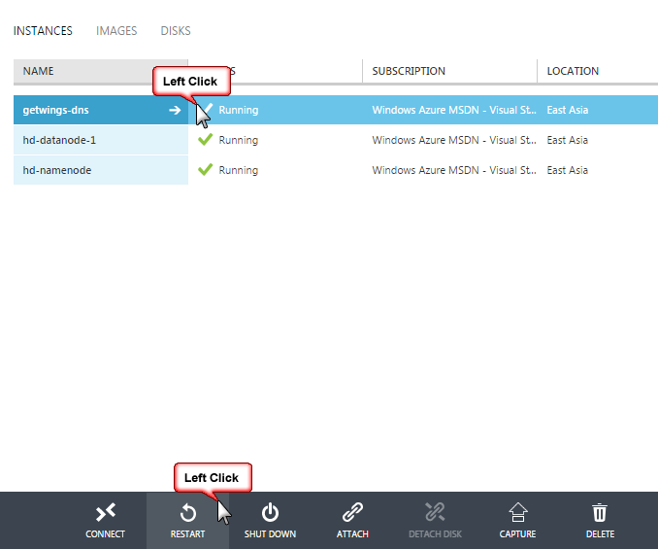

Slide 41
5. Verify the DNS server IP on the machine
Run powershell
use ipconfig /all to get configuration details of the network adapters on the machine

Slide 42
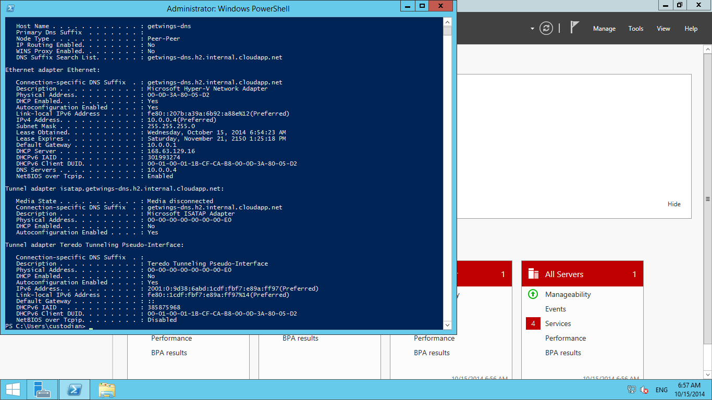

Slide 43
6. Create a VPN Network

Slide 44
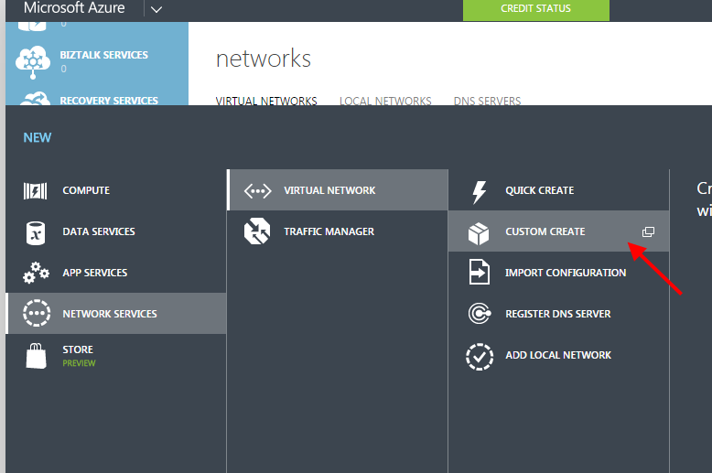

Slide 45
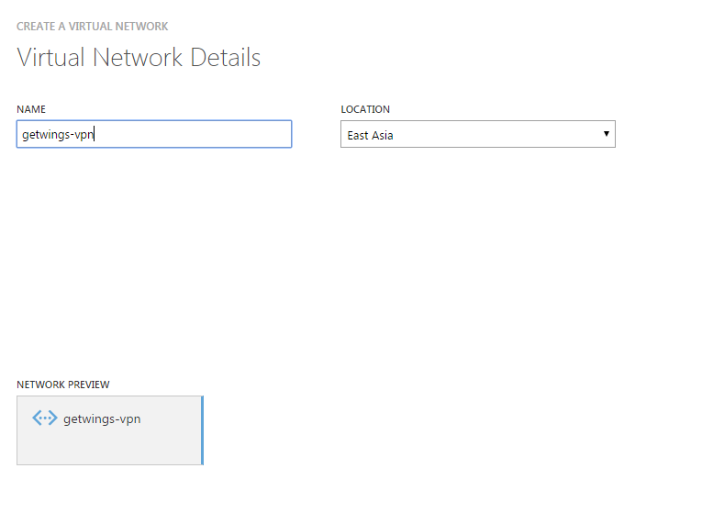

Slide 46
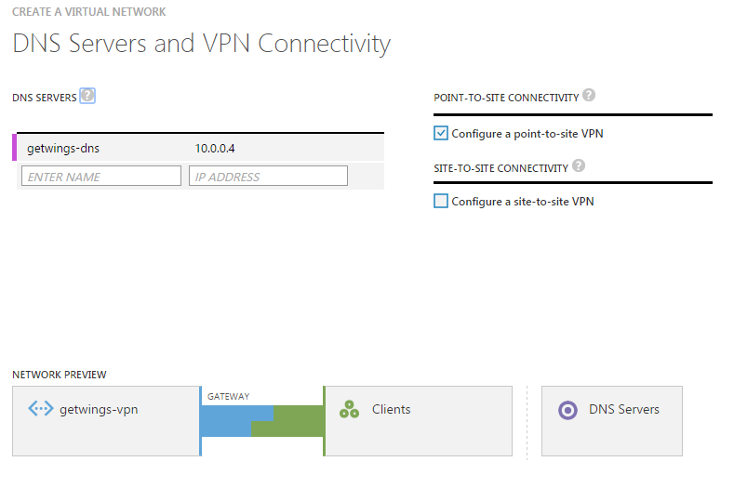

Slide 47
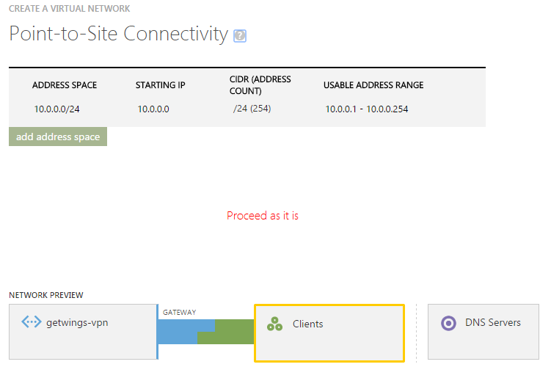

Slide 48
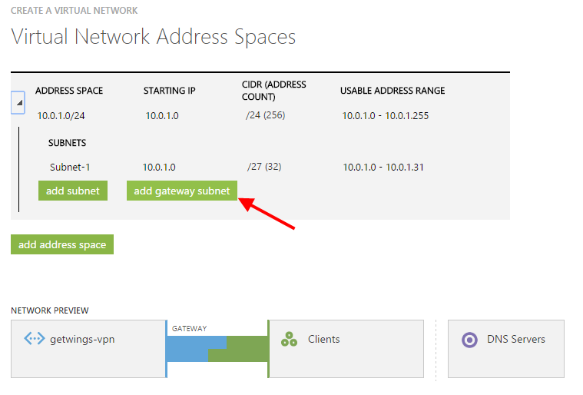

Slide 49
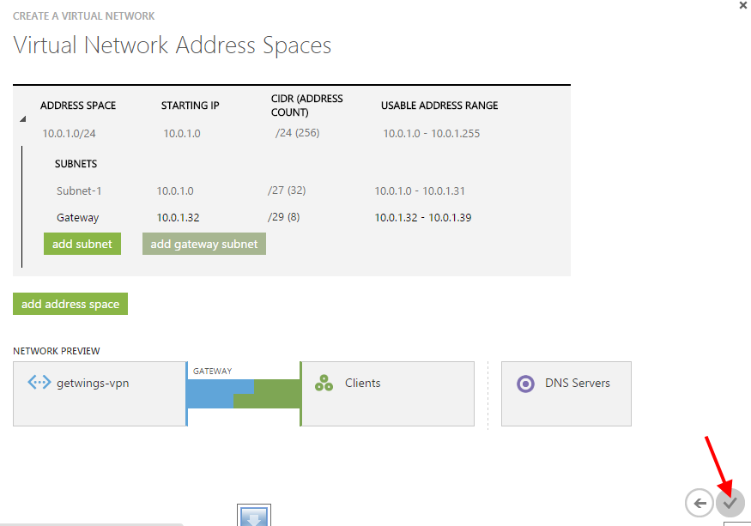

Slide 50
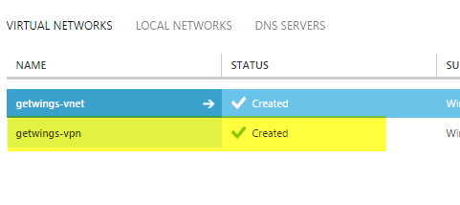

Slide 51
7. Create root certificate
You will need 2 certificates
Root certificate
Client certificate

Slide 52
Create self signed certificate
Path for makecert.exe: C:\Program Files (x86)\Windows Kits\8.1\bin\x64\makecert.exe
(Root certificate) Command: .\makecert.exe -sky exchange -a sha1 -r -pe -n "CN=GetWingsVPNRoot" -len 2048 -ss My
(Client certificate) Command: .\makecert.exe -n "CN=GetWingsVPNClient" -pe -sky exchange -m 96 -ss My -in "GetWingsVPNRoot" -is my -a sha1

Slide 53
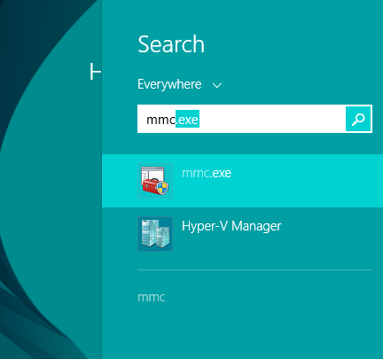

Slide 54
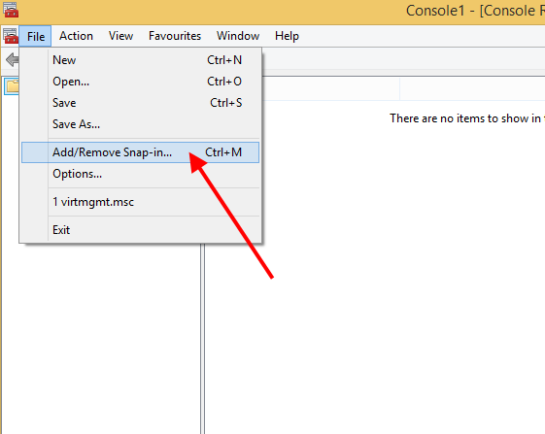

Slide 55
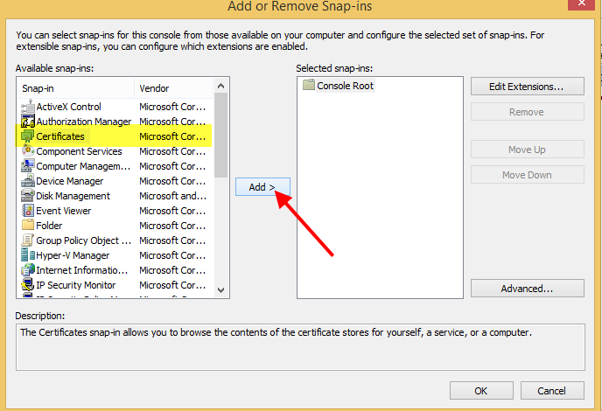

Slide 56
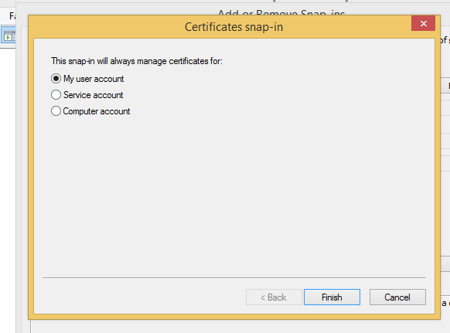

Slide 57
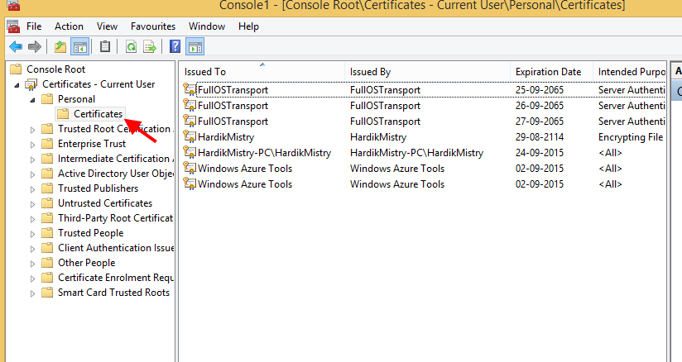

Slide 58
8. Use PowerShell or command prompt
with administrative privileges

Slide 59
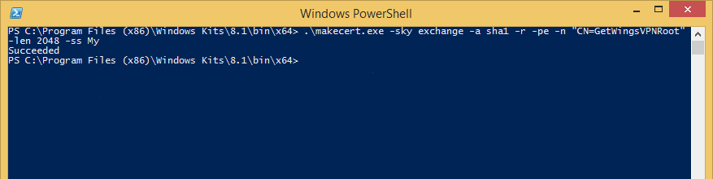
The following creates a root certificate

Slide 60
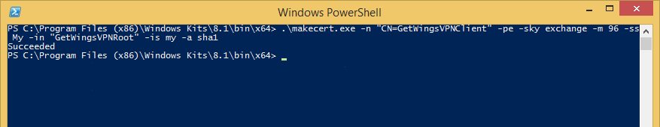
The following creates a client certificate

Slide 61
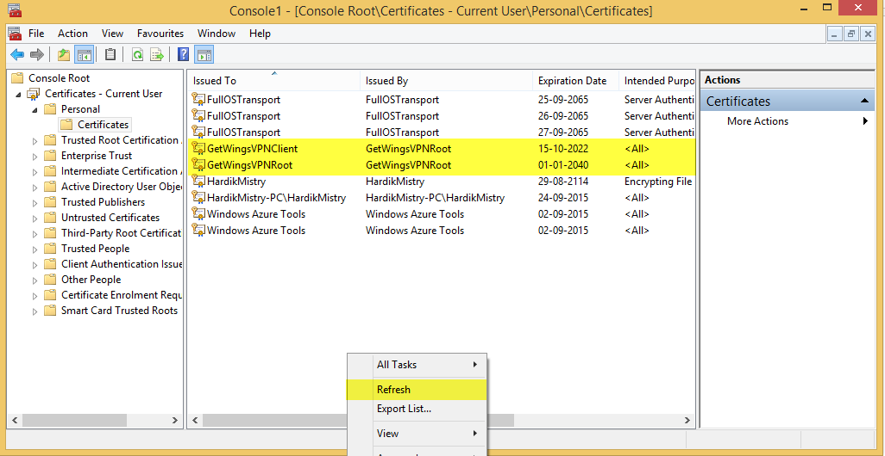

Slide 62
10. Export the Root certificate

Slide 63
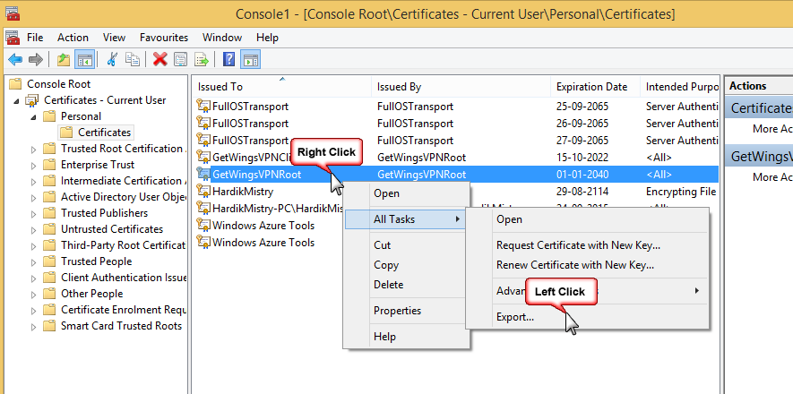

Slide 64


Slide 65


Slide 66


Slide 67


Slide 68
9. Upload the Root certificate in your VPN network on azure

Slide 69


Slide 70


Slide 71


Slide 72


Slide 73
10. Enable gateway in your VPN Network

Slide 74


Slide 75


Slide 76


Slide 77

Install the .exe you just download
On successfully completeing the installation, you can find getwings-vpn in the connections pane

Slide 78
11. Export the VPN Client certificate that you created in step 7

Slide 79


Slide 80


Slide 81


Slide 82


Slide 83


Slide 84
12. Import the client VPN certificate you just exported to appropriate store

Slide 85


Slide 86


Slide 87


Slide 88


Slide 89


Slide 90

13. Connect to your VPN using the connections pane

Slide 91


Slide 92


Slide 93
14. Verify you ip settings
Use ipconfig /all to get review the configuration of the network adapters on the machine

Slide 94


Slide 95

Once connected, you can verify your connection from Azure portal too

